Slide 1
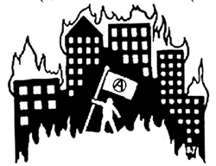
Anarchy
Type of government without rulers.
Followers reject leadership, control of the state.
Followers do not always prefer chaos.
Desire a voluntary government.
Possible Good Possible Bad
Nobody telling Violence and
you what to do disorder
You pay taxes if Safety is at
you wish risk, crime high
Notes:
*

Slide 2
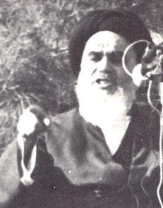
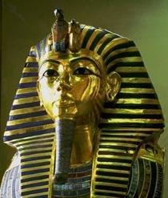
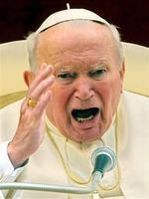
Theocracy
Government ruled by a religious leader.
Sometimes even a god.
Few places still continue this.
Often times religious freedom is forbidden because you must follow the dominant religion or be punished.
Possible Good Possible Bad
Religion may help Religious
citizens of the freedom may
country not exist [you
are forced to
believe a religion
you disagree with
Notes:
*

Slide 3
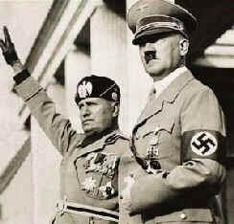
Totalitarianism
Root word:
Total
Government that controls every aspect of a people’s life.
Where you live, where you work and what you can say and cannot say.
Absolute power and control.
Nazi Germany and Fascist Italy were the most well known examples.
Possible Good Possible Bad
Very low crime Personal rights
because people are very
are in fear restricted
People are told People are told
what to do what to do
Notes:
*

Slide 4
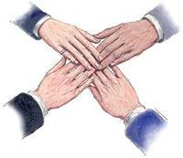
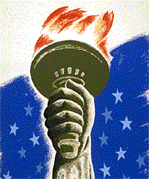
Direct Democracy
Ruled by the masses.
“Ruled by the people, of the people and for the people”
Rulers selected by “everyone.”
At times Ancient Rome was democratic.
The U.S. is a representative democracy because people there do not directly make the laws.
People chose other people in elections to make laws and decisions for them.
Notes:
*

Slide 5
There are 8 types of government. Describe the other types of government.

Slide 6
Section 1-Page 2
Region-area or place within a country, nation or territory.
Colony-a territory ruled by a mother country from far away.
Industries-Types of jobs and ways people earn money.
Region | Colonies | Religion/Religious Beliefs | Industries
Southern | Virginia, North Carolina, South Carolina, Georgia | Protestant but not very religious | Farmed large plantations that grew tobacco, corn, indigo and wheat
Middle | New York, New Jersey, Delaware, Pennsylvania, Maryland | Quaker and were against slavery | General farming and iron-working
New England | Massachusetts, Connecticut, Rhode Island | Puritans who were very religious and believed hard work brought them closer to God | Ship-building and fishing

Slide 7
Section 1-Page 3 Self-government
Examples of Self-government-
[1] England allowed each colony to rule itself with legislatures called House of Burgesses. Members of the House of Burgesses were elected by citizens of the colonies and were able to vote on laws that controlled the colonies.
[2] England did not force its colonies to pay taxes so people in America become used to having cheap goods. This policy was called Salutary Neglect.
[3] The Albany Plan of Union was the first time the colonies joined together on their own to fight a common enemy to protect themselves.
[4] The 1st Continental Congress was the first time the United States joined together to fight its former mother country England. After England shut down all trade in Boston after Americans refused to pay taxes they wrote a letter to the king asking him to treat them fairly. He refused and sent soldiers to force them to pay for their actions.

Slide 8
Section 1-Page 4
Ways England controlled and mistreated its American colonies
The strategies and events below created problems between England and its colonies in America
Term/Topic | Definition/Description | Negative effects
Mercantilism
French and Indian War
Stamp Act
Tea Act
Writs of Assistance
Intolerable Acts/Coercive Acts
Trade system that forced American colonies to only buy/sell to England.
Ended Salutary Neglect and raised prices on goods in America.
Expensive war England forced its colonies to fight against France to protect the American colonies.
Created huge debt that American colonies were force to repay with stricter taxes.
Tax England placed on reading materials in the American colonies.
Angered the colonists because prices increased.
Tax England placed on tea in the American colonies. American colonies rebelled and refused to pay the tax.
Angered colonists said they had no say about new taxes so they claimed No taxation without representation
Legal documents England used to allow soldiers to search American homes and businesses
Angered colonists because their privacy was violated
Laws England passed to shut down all trade in Boston after the Boston Tea Party
Ended colonists ability to buy goods and made them want to fight England

Slide 9
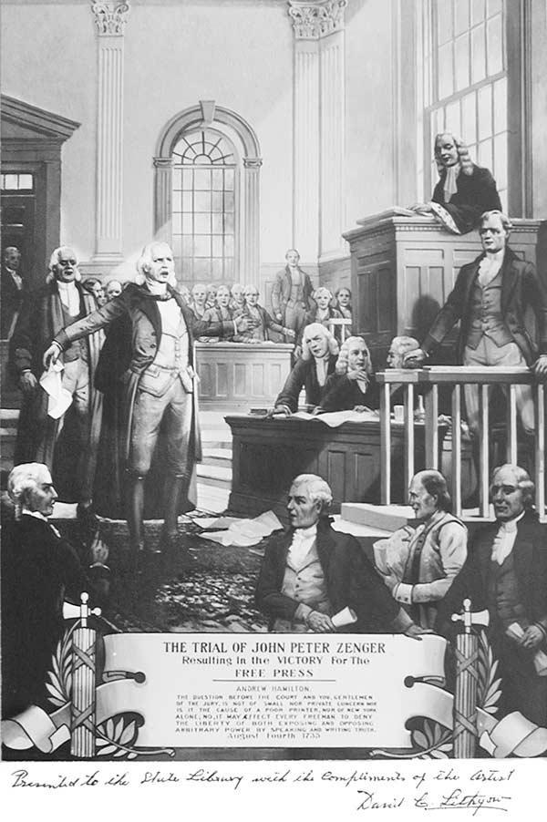
Freedom of the Press
John Peter Zenger, a New York newspaper editor, printed a series of articles criticizing the corruption of the governor of New York.
The governor of New York was taking bribes and giving jobs to his friends.
Zenger exposed the governor’s misuse of power and was arrested as a traitor.
Zenger was accused of libel [lying in writing]
Zenger was found not guilty at his trial because had written the truth
This ruling set a precedent for freedom of the press and speaking out against a bad government
Notes:
*

Slide 10
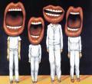
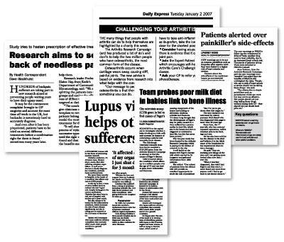
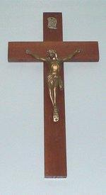
The Bill of Rights
The Rights and freedoms of American citizens are listed in the Bill of Rights-
Amendment I: freedom of religion, assembly,, petition, press and speech
Amendment II: right to bear arms [have weapons]
Amendment III: freedom from quartering
Amendment 4: freedom from search and seizure
Amendment 5: right to justice; freedom from double jeopardy; self incrimination, eminent domain
Amendment 6: right to a fair trial with a lawyer
Amendment 7: right to a jury trial
Amendment 8: protection from cruel and unusual punishment
Amendment 9: rights ratified anywhere shall not reduce these
Amendment 10: any rights not listed left to states or people
Notes:
*

Slide 11
Constitutional Amendments
13th Amendment- Anti-Slavery [forbids slavery in the U.S. for any reason]
14th Amendment- Due Process and Equal Protection Under the Law Clause
15th Amendment- Right to vote cannot be deprived based on race, color or previous slavery
16th Amendment- Income Tax
18th Amendment- Prohibited making, having, selling and using drinking alcohol
19th Amendment- Right of women to vote
21st Amendment- Repealed [ended] prohibition against drinking alcohol.
22nd Amendment- Limit of 2 four year terms for the president
26th Amendment- Right to vote for U.S. citizens 18 years and older.

Slide 12
The Articles of Confederation
The American colonies came together and wrote a plan of government to unite the new independent states.
The document was called the Articles of Confederation
The rules written down were not very strict because the United States did not want to be controlled again by a strong centralized government.
Weaknesses-[a] hard to pass laws [b] hard to change laws [c] could not tax its citizens [d] no way to enforce laws

Slide 13
The Constitutional Convention
The new states met together in Philadelphia to create a new plan of government to unite the states the U.S. Constitution
People in the United States began to “take sides” and choose which type of government they wanted
Factions developed.
A faction is a group of people who comes together to organize and get something accomplished
The two main factions were:
Federalists-This group wanted create a constitution that would unite all 13 colonies under one government
The Federalists supported the U.S. Constitution
The Anti-federalists were worried that a national government would be just like Great Britain and control citizens too much.
Anti-Federalists were against the U.S. Constitution
The anti-federalists wanted to guarantee personal freedoms such as speech and religion

Slide 14
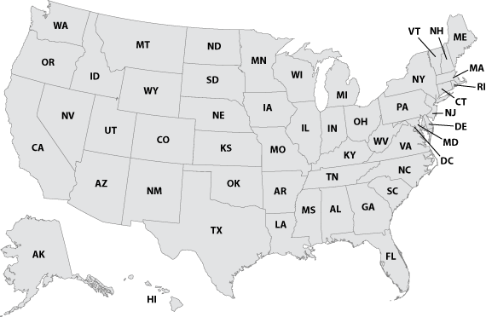
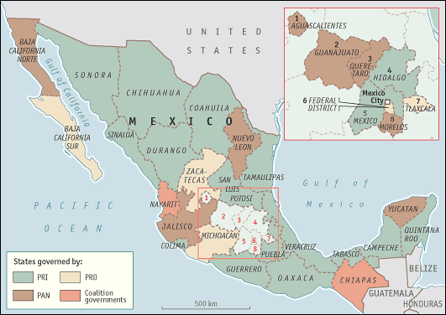
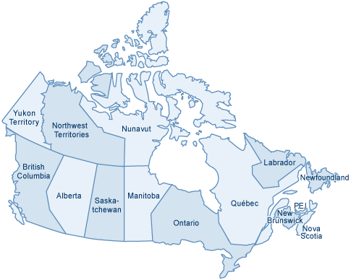
Federalism
Federalism- Type of government with separate and individual (sovereign states).
Sovereign means rule over itself.
A federal government shares power between national and state governments.

Slide 15
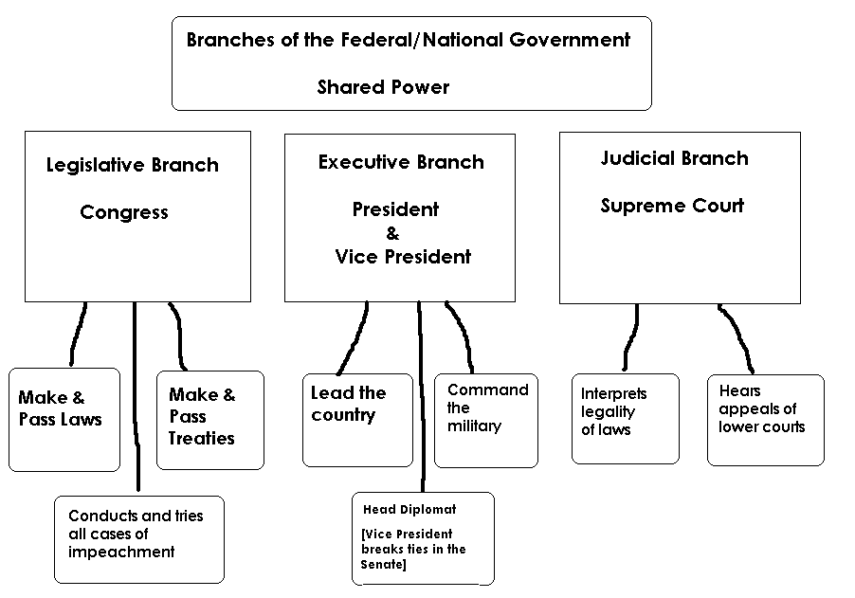
The Virginia Plan [large states]
James Madison came up with a plan of shared power within the new federal government.
There would be three (3) branches [parts] of government.
A federal/national Legislature [Legislative]
To propose, debate and pass laws
A federal/national Judiciary [Judicial]
To interpret laws and hear appeals from lower courts
An federal/national President
[Executive]
To lead and ensure laws passed by the Congress are enforced

Slide 16
The New Jersey Plan [Small states]
In response to the Virginia Plan states with smaller populations became nervous.
New Jersey believed larger states would dominate the Congress.
They believed each state should have equal representation.
No one state should be more powerful than another.

Slide 17
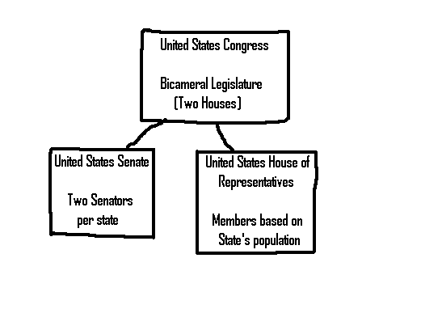
Connecticut’s Great Compromise
The Delegates from Connecticut had an idea to bring all sides together.
A compromise to blend the ideas of Virginia and New Jersey created a bicameral legislature
The new Congress would have two [2] separate houses.
The Senate and the House of Representatives
The Senate would have equal representation [2 per state]
The House of Representatives would have membership based on the state’s population [larger states would have more]

Slide 18
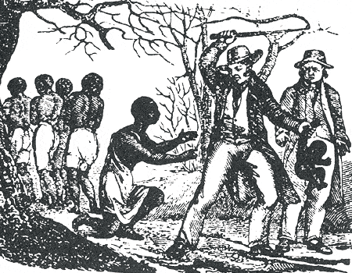
Compromises for a New Federal Legislature
Three/fifth’s Compromise
Slave states wanted to include slaves in their population counts even though slaves were not considered citizens.
If allowed this would have boosted population count and granted more representatives to slave states in the federal legislature.
Benefited big states such as Virginia.
This would have created more voting power in the Congress.
States with large slave populations struck a deal with Northern states.
For every 5 slaves they were allowed to count 3 for purposes of population.

Slide 19
Assignment: What Would You Do Chart
Presidential Power | Description of Power [Be specific and detailed] | When, Why or How he would use it? [Be specific and detailed]
Veto
Commander-in-Chief
Appointments
Pardon
Reprieve
Commutation
Executive Order

Slide 20
President’s Powers…
Executes the laws (carries out, enforces) passed by Congress.
Veto (reject) bills passed in Congress
Serves as Commander in Chief of the armed forces.
Receives leaders and other officials of foreign countries.

Slide 21
President’s Powers…
Make treaties with other countries [the Senate holds hearings then votes to confirm or reject the treaty].
Appoints people to high level jobs [recommends, selects] heads of executive agencies, federal court judges, ambassadors, and other top government officials
[the Senate holds hearings (interviews) then votes to confirm or reject the appointment].

Slide 22
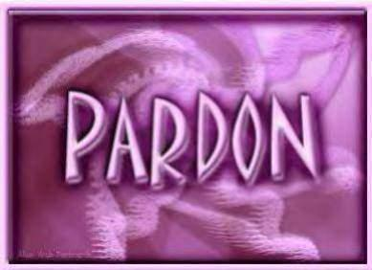
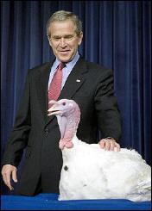
Exclusive Powers
The president has some powers others do not have.
Pardon
To forgive a crime after a conviction in court trial.
Person is released from prison sentence.
Reprieve
Temporary delay of punishment.
He can decide to postpone a prison sentence while he decides whether to pardon someone
Commutation
He may commute [reduce/decrease] a convicted criminal sentence/punishment [usually death penalty to life sentence]
Former President Bush pardoning a Thanksgiving Day Turkey

Slide 23
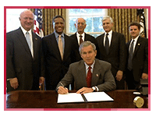
Exclusive Powers
Executive Order
Power to declare a policy that has the force of law.
Almost a power like a king would have but if it is considered to be “unconstitutional” it can be struck down or overturned by the U.S. Supreme Court.

Slide 24
Party Leader
Supports party members in election campaigns [by making appearing appearances, providing personal approval and helping to raise money]
Helps unify the party [unite/bring together] and give it direction [this can be harmful to the party if the president is not popular]

Slide 25
Chief Diplomat
“Deals” with the leaders of foreign countries
Appoints ambassadors
Makes treaties and executive agreements [trade and military]

Slide 26
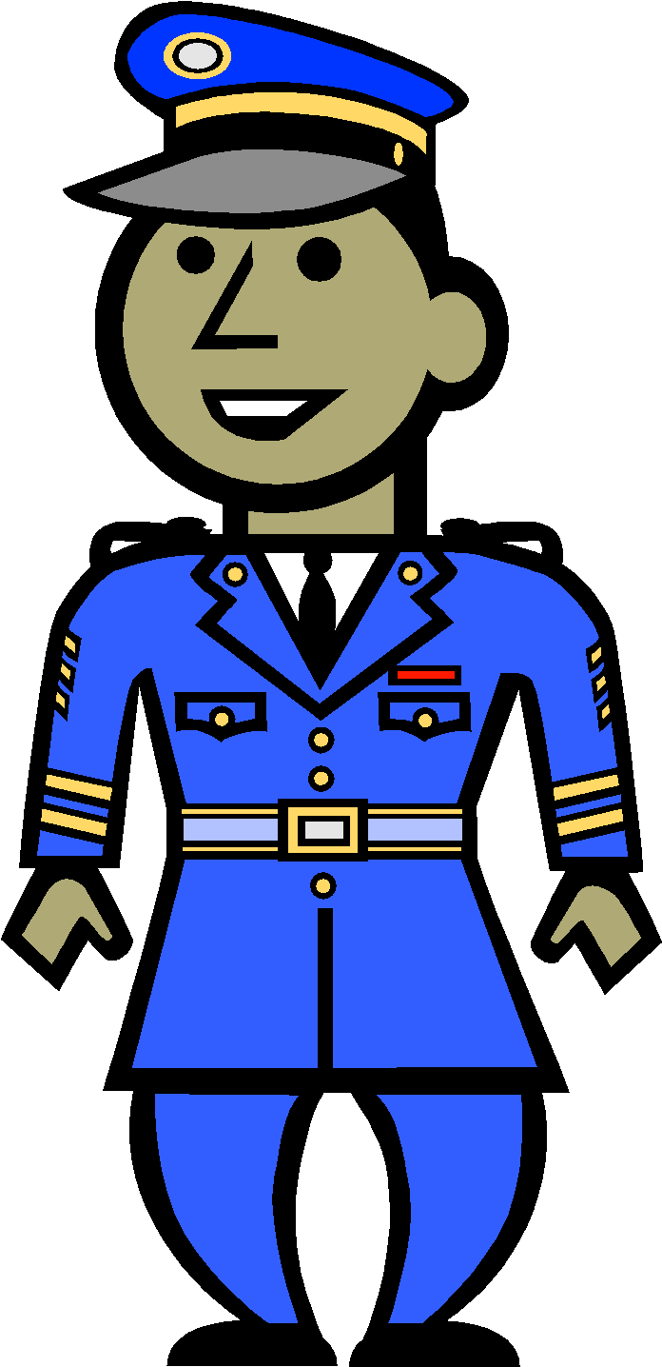
Commander in Chief
President has final authority over all military matters.
Checks and balances:
Congress declares war
President can order troops into battle
War Powers Act 1973 [limited the President’s war power. After 60 days he must ask Congress to allow troops to stay at war.

Slide 27
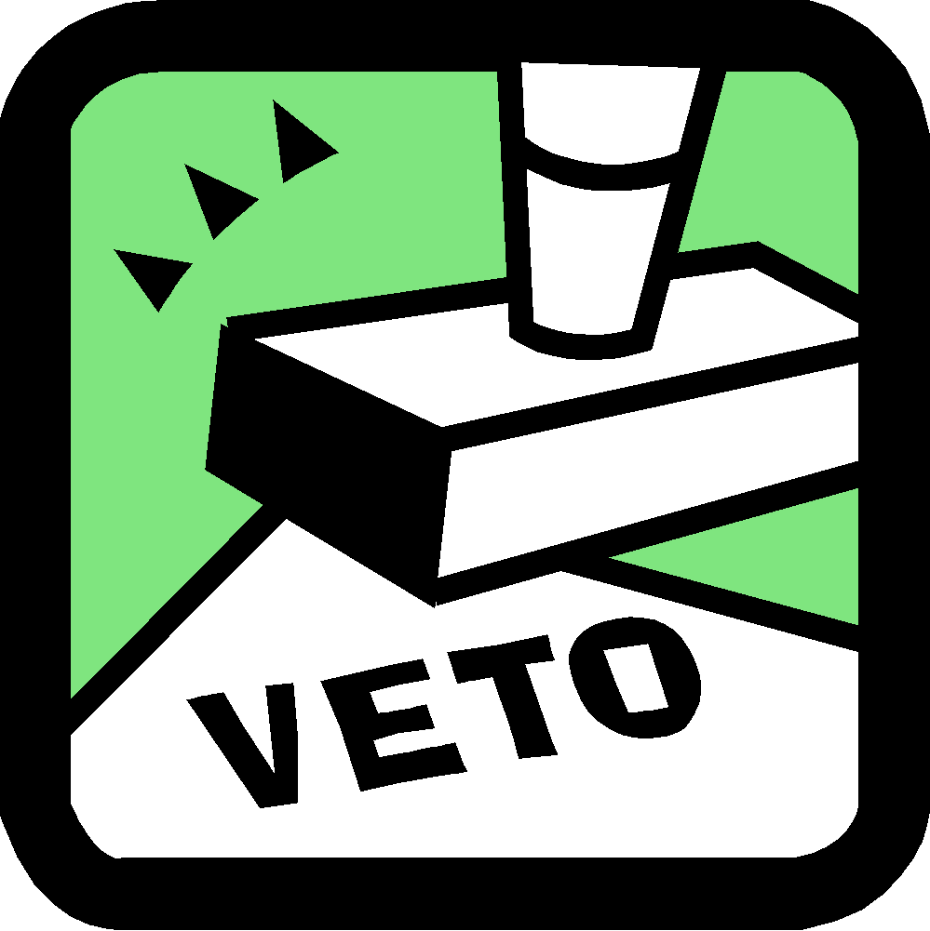
Legislative Leader
Introduces/ Proposes Laws
Calls special sessions of Congress to consider urgent matters
Approves or vetoes legislation [laws]

Slide 28
There are 7 roles of the President. Describe the other roles.

Slide 29
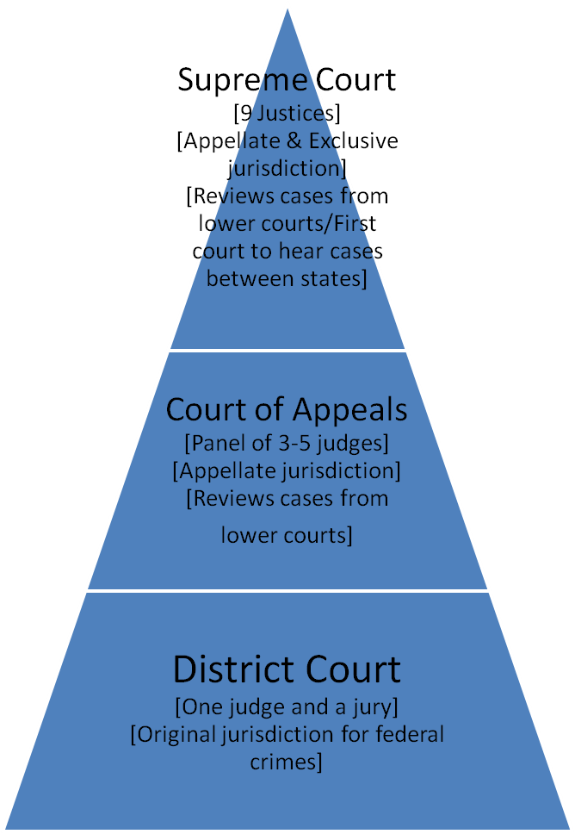
Judicial Branch
The U.S. Judicial Branch consists of three different courts
Courts are responsible for interpreting the law which means they can review laws and decisions from lower courts and decide if they are constitutional.
Laws or decisions that do not follow the US Constitution be overturned or reversed.

Slide 30
Landmark Court Cases
Marbury vs. Madison-first court case that courts used the power of judicial review [power to reverse a lower court’s decision or declare a law unconstitutional]
Miranda vs. Arizona-Court case guaranteeing citizens’ rights to remain silent during police questioning [5th Amendment].
Mapp vs. Ohio-Court case protecting citizens’ from unlawful searches [4th Amendment].
Plessy vs. Ferguson-Court case that established the principle of separate but equal allowing government racial discrimination[14th Amendment].
Brown vs. Board of Education-Court case that reversed the Plessy decision and forbade segregation.
Tinker vs. DesMoines-Court case that established freedom of expression as a from of freedom of speech [1st Amendment].
State vs. Mann-North Carolina court case that allowed slave masters to have complete control over their slaves [14th Amendment].
Leandro case-North Carolina court case that guaranteed students the right to a sound basic education no matter if it was in poor or rich county [14th Amendment].

Slide 31
Political Parties
A political party is a group of people with common ideas about how government should operate.
The organization selects and supports people called candidates to win elections and run the government “their way.”
Some political parties want government more involved in people’s lives.
Some political parties want government less involved in people’s lives.

Slide 32
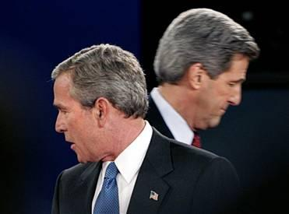
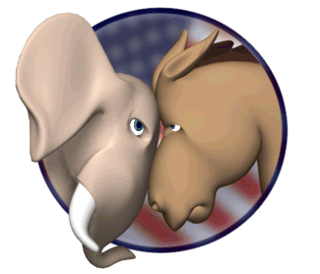
Two Party System
The United States has a two party system which means there are two main political parties.
The Democrats (Donkeys)
The Republicans (Elephants)
Each political party has a different position called platforms or planks.
These platforms or planks are the sets of ideas used to identify with voters to gain support for election.

Slide 33
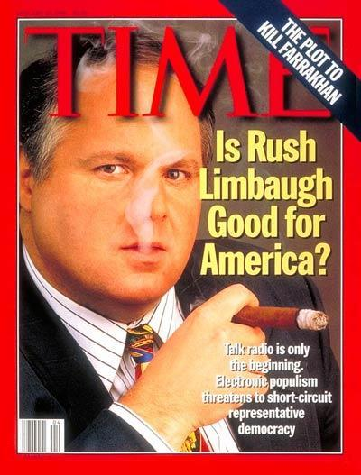
Republicans
The Republican party is usually considered to be conservative.
Conserving the rights listed in the Constitution such as freedom of speech, freedom of religion and Due process.
Against government intrusion and high taxes.

Slide 34
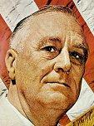
Democrats
For most of history the Democrats have been considered to minority groups.
More government intervention and public assistance.
This is considered to be liberal.
Liberal means for government to get more involved into peoples’ lives with laws and control.

Slide 35
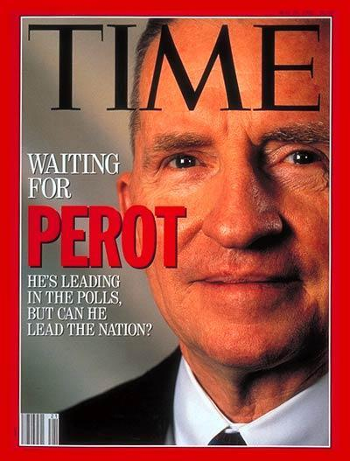
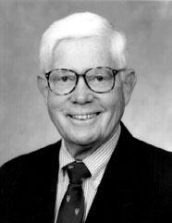
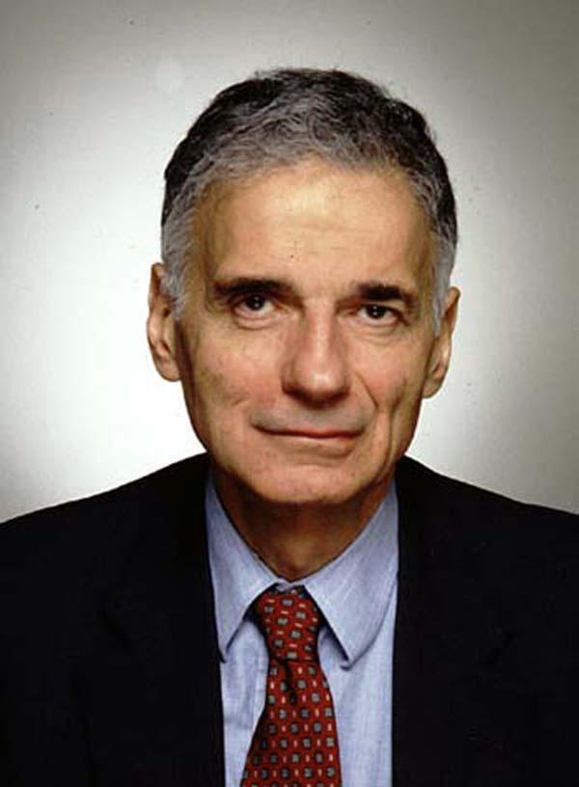
Third Parties
When Democrats and Republicans “screw up” or do a “bad job” it creates chances for others.
John Anderson, Ross Perot and Ralph Nader have made serious runs at political office.
They usually only receive small support.
Votes for them sometimes called protest votes.
Reform Party-Created to “fix” problems made by Democrats and Republicans.
Green Party-Created to support issues about protecting the environment.
Libertarian-Created to support efforts to limit the power and control of federal and state government over citizens.

Slide 36
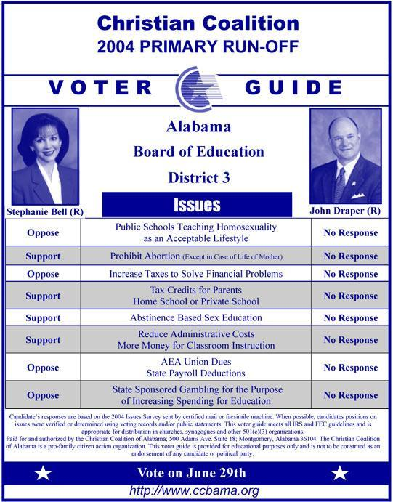
Primary Elections
First election (or series of elections) for a candidate.
Sometimes referred to as a “family fight.”
Held to decide who will represent the party.
In closed primaries only registered members of that party may vote in the primary election.
Open primaries allow independents or other registered voters to vote in them. Open primaries are rare.

Slide 37
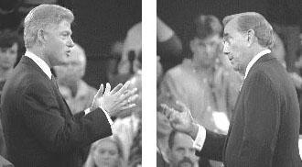
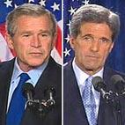
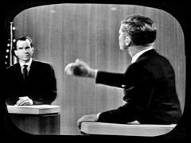
General Election
Final election to a political office for a candidate.
Contest between the two main candidates [Democrat v. Republican].
Held to see who will represent the entire area [district, state or nation]. Held to see who will hold that office ex: president, mayor
Any registered voter may participate in this election.

Slide 38
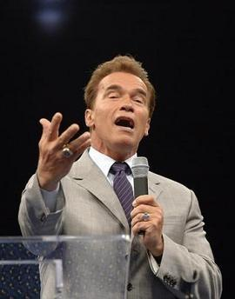
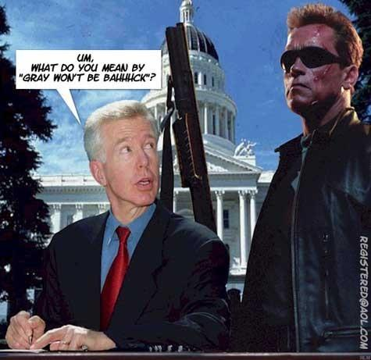
Special Election
In the event of a death or removal from office new elections are needed.
Because of a recall.
Terms of office will complete the prior holder’s term.
Several years ago California Governor Gray Davis was recalled by the state’s voters in a recall election.
In a special election Arnold Schwarzeneggar was elected the new governor.

Slide 39
Some tactics candidates use to win elections
Use the mass media [T.V. commercials, websites, radio ads] to reach and convince voters
Polling-Paying organizations to ask voters their opinions about what they believe and who they might vote for. Candidates make important based on this information [Before the election].
Canvassing-Candidates go “door to door” speaking to voters introducing themselves and getting to know the community.
Exit Polling-Volunteers ask people coming out of voting booths who they voted for. If the information is received early enough the candidate can run last minute ads and commercials to “blitz” the voting district with information.

Slide 40
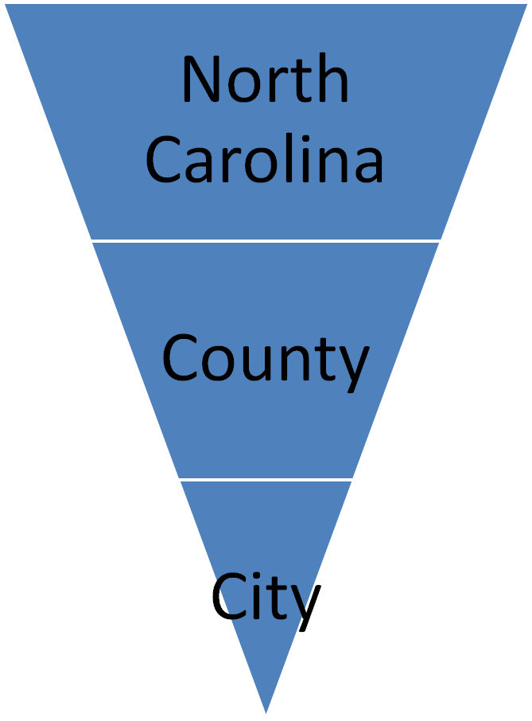
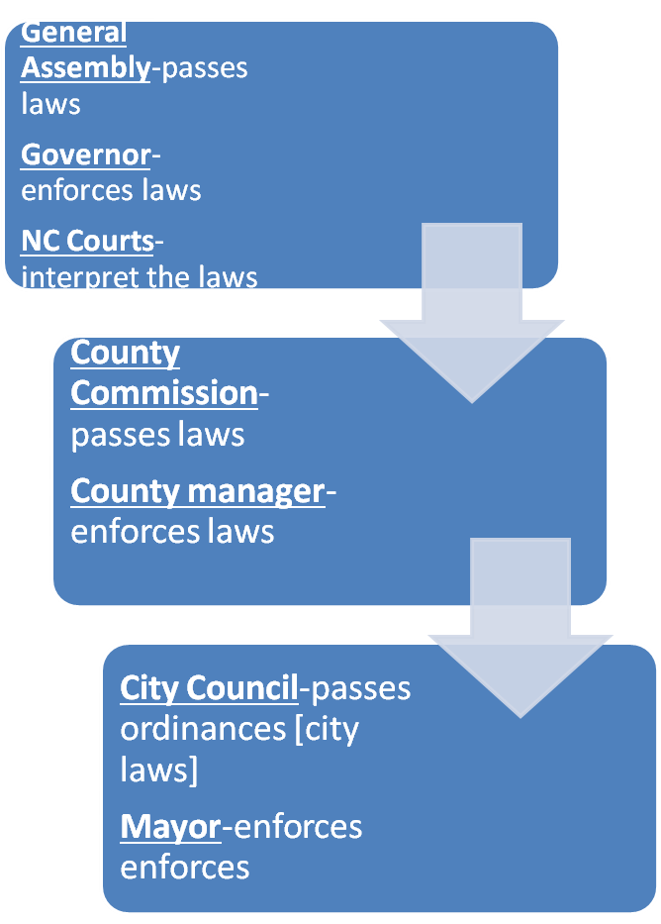
Levels of State & Local Government

Slide 41
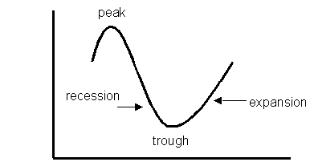
Business/Economic Cycle
Peak-the highest point during the business/economic cycle. Businesses are most likely to invest in new capital goods to expand their business further.
Recession-the point when businesses begin to fail because of bad business decisions and rising unemployment.
Trough-the lowest point in the business/economic cycle when sales are low and unemployment is high.
Expansion-the point in which the economy begins to recover and employment starts to rise.

