Slide 1
Unit 2: Foundations of American Government

Slide 2
Procedures Quiz
You have 10 minutes to complete this quiz.
You may use your note book but you may not:
Share notes
Talk
Use technology
Keep your eyes on your own paper!
Violators will get a zero!

Slide 3
Homework Policy
You will get a homework packet Monday and the will be due Friday the same week unless otherwise noted.
HW packets are due Fridays to avoid giving weekend homework and you can work at your own pace.
Additionally, each day you need to write questions for your Cornell Notes for the day. This should take you about 10-15 minutes daily.
HW packet #1 due this Friday, Sept. 4th.

Slide 4
Warm-up
Answer the following questions in one paragraph:
1.What rights do you think people are born with?
2. Does it make more sense to divide up a govts power between individuals or groups, or does it make more sense to have it all in one place? Why?
3. What do you think a govt should do for its people? What do you think people should do for the govt?

Slide 5
Enlightenment Thinkers
EQ; How did ideas from Enlightenment philosophers influence principles of American government?

Slide 6
Key Vocab
The Enlightenment – 17th and 18th century European cultural movement that in part defined the relationship between the governor and the governed.
Civil Liberty – Rights held by members of a society.
Social Contract – a power sharing agreement between a government and it’s people.

Slide 7
Who is John Locke? What did he believe?
Viewpoints
All humans have “natural rights” (life, liberty, property, pursuit of happiness)
We obey govt (give up some rights), govt protects us.
This is the social contract theory!

Slide 8
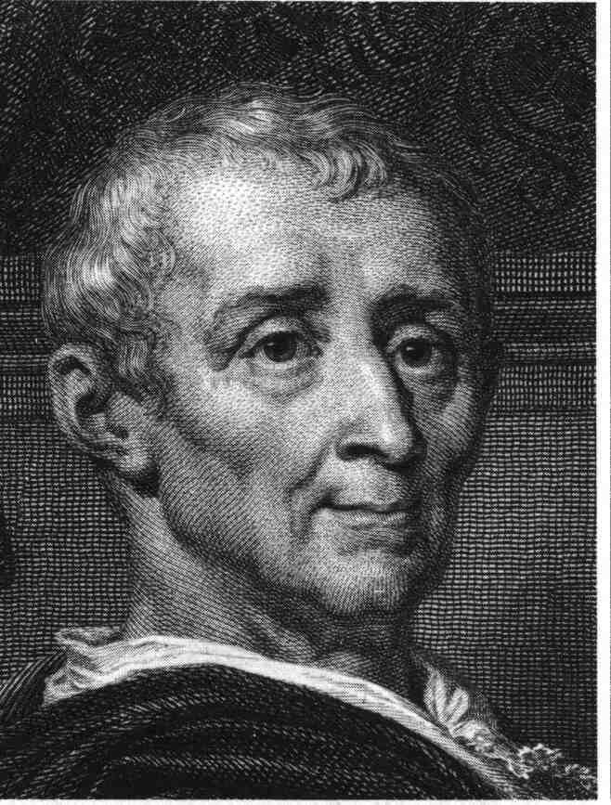
Who is Montesquieu? (France) What did he believe?
Viewpoints
Believed too much power in one place is dangerous for others
Introduced “Separation of Powers” between branches of government
Where do we see the separation of powers in our govt?

Slide 9
Who is Rousseau? (France) What did he believe?
Viewpoints
Humans will destroy themselves if they don’t give up some freedoms!
Humans create a “social contract” with government to protect themselves
How is Rousseau different from Locke?
Both believe in Social Contract however, Rousseau believes in direct democracy; power comes from the people!

Slide 10
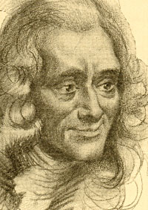
Who is Voltaire? (France & England) What did he believe?
Viewpoints
Believed in Civil Liberties
Trial by Jury of peers
Freedom of Religion
Freedom of Speech

Slide 11
Exit Ticket
How does the U.S. Constitution conform to John Locke’s social contract theory?
a. The government operates on a system of law that is based on contracts and statues.
b. Citizens transfer some rights to government in exchange for social order.
c. States retain sovereign powers and are joined by confederation.
d. People agree to a social system guided by conscience.
Which is true of Enlightenment Thinkers like John Locke, and Jean Jacques Rousseau?
a. They believed that monarchs should have absolute power.
b. They though churches should have ultimate authority.
c. They believed in a social contract between government and the people.
d. They invested in joint-stock companies and started colonies in the New World.

Slide 12
Exit Ticket
“We hold these truths to be self-evident, that all men are created equal, that they are endowed by their creator with certain unalienable Rights, that among these are Life, Liberty, and the pursuit of Happiness…”
- The Declaration of Independence
Which Enlightenment Thinker probably inspired the excerpt above?
a. John Locke
b. Baron de Montesquieu
c. Jean-Jacques Rousseau
d. Voltaire

Slide 13
Reflection
Speech and the Social Contract. The U.S. Constitution says the government cannot limit freedom of speech. Is freedom of speech necessary in order to enjoy our natural rights? Pick ONE natural right and explain why it can’t be fully enjoyed without freedom of speech.
Natural Rights include life, liberty, happiness and property. Answer in a paragraph or two.

Slide 14
Road Map to Success

Slide 15
Warm-up
Who believed in civil liberties?
Which two philosophers developed the social contract theory?
According to social contract theory, what should people do if the government doesn’t protect their rights?
What did John Locke say were our natural rights?

Slide 16
Homework Policy
You will get a homework packet Monday and the will be due Friday the same week unless otherwise noted.
HW packets are due Fridays to avoid giving weekend homework and you can work at your own pace.
Additionally, each day you need to write questions for your Cornell Notes for the day. This should take you about 10-15 minutes daily.
HW packet #1 due this Friday, Sept. 4th.

Slide 17
Founding Documents
EQ: How did foundational documents provide stepping-stones for American Government?

Slide 18
Key Vocab
Govern – Ruling over other people.
Limited Government – The government has to follow it own rules.
Direct Democracy – The people vote directly on the issues.
Representative Democracy – The people elect their peers to vote on issues for them.
Popular Sovereignty – The power of the government is based on us allowing them to govern.

Slide 19
Magna Carta
Signed in year 1215 …
Limited power of the King.
Gave people rights.
Led to… limited gov’t!
How did England change after the Magna Carta?
The King/Queen no longer have total power
They must answer to a counsel
Trial by jury is created

Slide 20
Mayflower Compact - 1620
Pilgrims came over on the Mayflower (their boat.)
No laws when they got here!
Mayflower Compact was the first to set up self-government in the colonies.
Example of social contract

Slide 21
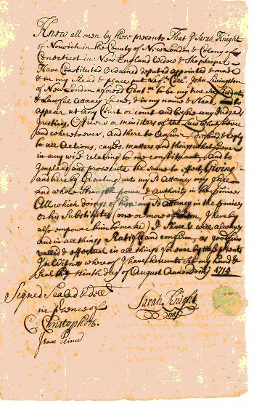
Fundamental Orders of Connecticut - 1639
First colonial constitution
In other words…first time a document was written in colonies to lay out a plan of government.

Slide 22
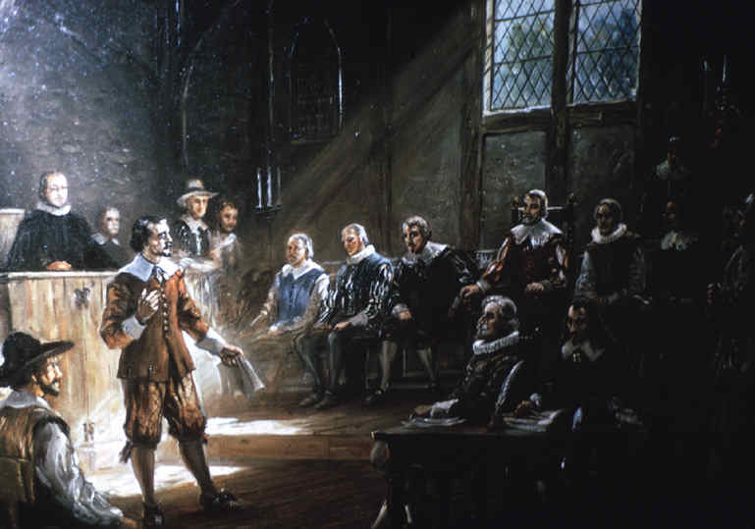
Virginia House of Burgesses 1643 to 1776
An early example of representative democracy.
Virginia settlers elected their peers to represent them in government.
This idea will become the foundation of Congress.

Slide 23
New England Town Hall Meetings 1643 to 1776
First example of a Direct Democracy in the colonies.
Townspeople would attend meetings and would all vote on any laws or issues.
This represents Popular Sovereignty (we give the govt its power).

Slide 24
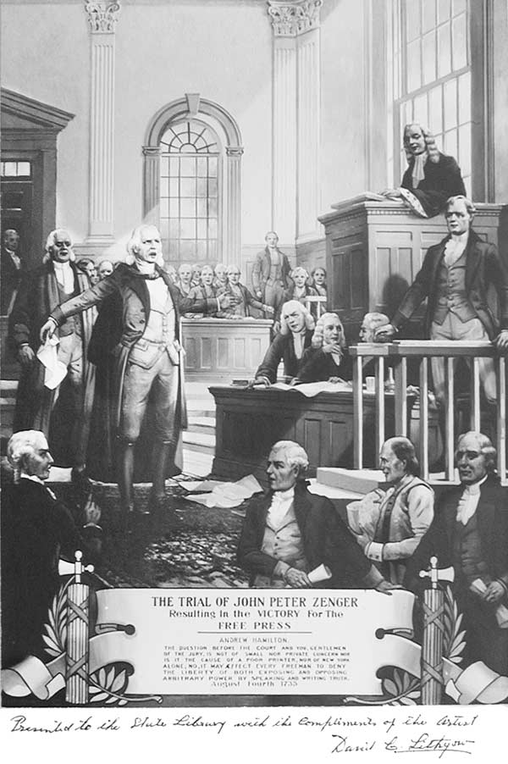
John Peter Zenger Trial - 1735
Zenger was accused of libel (printing harmful things about governor.)
Found not guilty!
Led to…freedom of press!

Slide 25
Declaration of Independence – 1776 (Thomas Jefferson)
The formal declaration of separation from Great Britain.
Sets forward all of the ideals that America is founded upon.
Life, Liberty, the Pursuit of Happiness.
Equality for all men.
Contains a list of grievances towards the King of England.
A “breakup letter” of sorts.

Slide 26
Exit Ticket
The Virginia House of Burgesses and Fundamental Orders of Connecticut are examples of which of the following?
a. They were documents encouraging colonist to declare independence
b. They helped establish the principle of democracy in the colonies
c. Each document helped to establish the precedent of religious freedom
d. They were used to create a monarchy in the colonies.
What was the political significance of the Virginia House of Burgesses?
a. The House of Burgesses was the first example of separation of church and state.
b. The House of Burgesses was the first example of religious tolerance.
c. The House of Burgesses was the first representative democracy in the colonies
d. The House of Burgesses was the first theocracy in the colonies

Slide 27
Foldable
Create a foldable containing six of the founding documents (0f your choice).
In each segment you should include:
Name of the document
Date written
An explanation of the impact of the document on America’s founding.
How can you still see it in American society today?

Slide 28
Reflection
Morgan Freeman on the Declaration of Independence
After watching the video answer the following in a paragraph or two.
Is the Declaration of Independence still relevant today? Why or why not?

Slide 29
Warm-Up
Imagine the first day of school. You walk into the room and sit down. The teacher walks in and writes the rules on the board and then leaves. The first day almost everyone does there work and follows the rules. A week passes and each day you arrive and your assignment is written on the board, but your teacher never shows back up. By the end of the week, many of your classmates are goofing off and not finishing there work. At the end of the semester one or two people are doing their work and everyone else is either sleeping or talking. The teacher shows back up and starts writing everyone referrals.
Is this fair? Why or why not. Respond in 4 – 5 Sentences

Slide 30
Causes of the Revolution
EQ: What were the causes of the American Revolution?

Slide 31
Key Vocab
Mercantilism – An business system where a country creates colonies and the colonies provide resources back to the home country. Places restrictions on Colonists!
Acts – British laws
Salutary Neglect – Ignoring a colony and allowing it to govern itself.
Declaration – A statement made to the public.

Slide 32
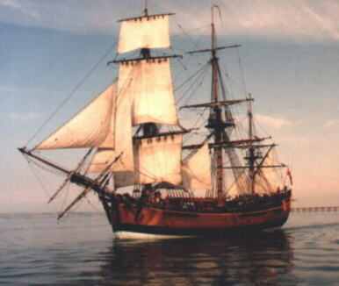
1. Salutary Neglect (Ends 1763)
When the government does not enforce laws and intentionally ignores the actions of it’s people.
Exactly what happened with Great Britain towards the colonies!
What laws were they not enforcing?
Navigation Acts (1600s)- Laws stating colonies were only allowed to trade with England
Colonist do not follow this because they wanted to trade with other nations for more $ (mercantilism)

Slide 33
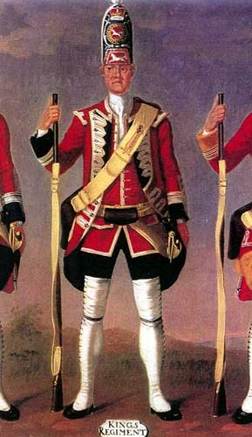
2. French and Indian War – 1754-1763
Fought between England & France
After winning, England had built up a large debt from the war
Colonies used to repay debt

Slide 34
3. Proclamation of 1763
Created the Proclamation Line which forbade colonists from moving into the Ohio Valley
Further upset colonists

Slide 35
4. Stamp Act - 1765
A special tax put on all paper goods in the colonies
Colonists refused to pay the tax and boycotted taxed items

Slide 36
5.“No Taxation without Representation”
Colonial statement that it was unfair for England to tax the colonies if the colonists didn’t have a say in the tax.

Slide 37
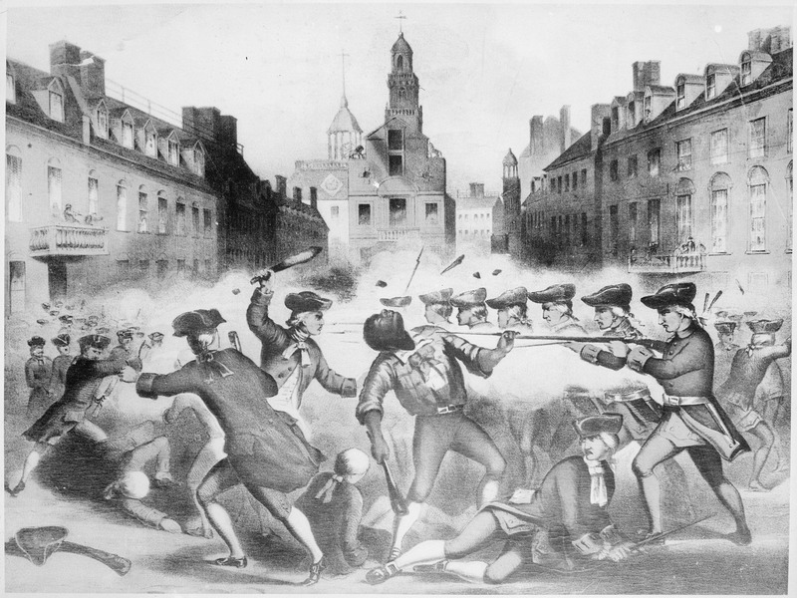
What else do they do to make us angry?
Boston Massacre (1770) – British soldiers kill five colonists in a riot.

Slide 38
6. Tea Act - 1773
Colonists were forced to buy all tea from the British East India Company
Colonies boycotted the tea
The Boston Tea Party

Slide 39
7.The Boston Tea Party- 1773
In protest to the Tea Act, the Sons of Liberty (a protest group) destroyed British tea by throwing it into the harbor

Slide 40
8. Intolerable/Quartering Acts - 1774
England punished Boston for the Tea Party by closing Boston’s harbor and taking away civil liberties
Quartering Acts forced Boston residents to allow soldiers to live in their homes.

Slide 41
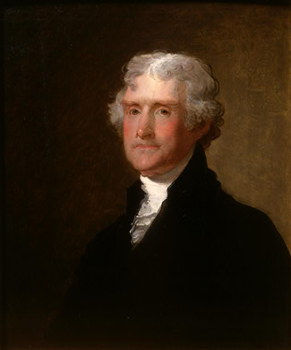
What do the Colonist do? Second Continental Congress -1776
Jefferson writes the Declaration of Independence which explains why the colonies want to separate from England

Slide 42
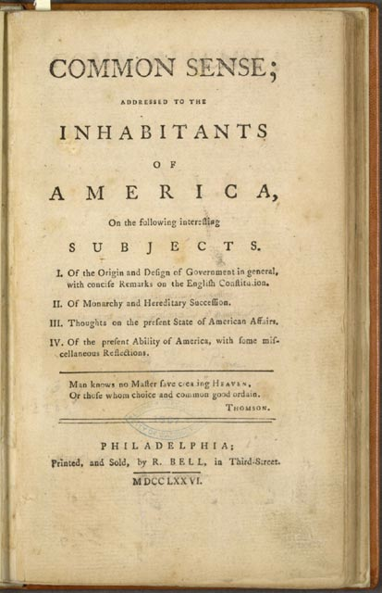
What do the Colonists do? Common Sense by Thomas Paine
Main Points
The colonies are too far away and too big for England to rule.
Colonies would be better off without England
Persuaded many colonists that is was time to separate from England

Slide 43
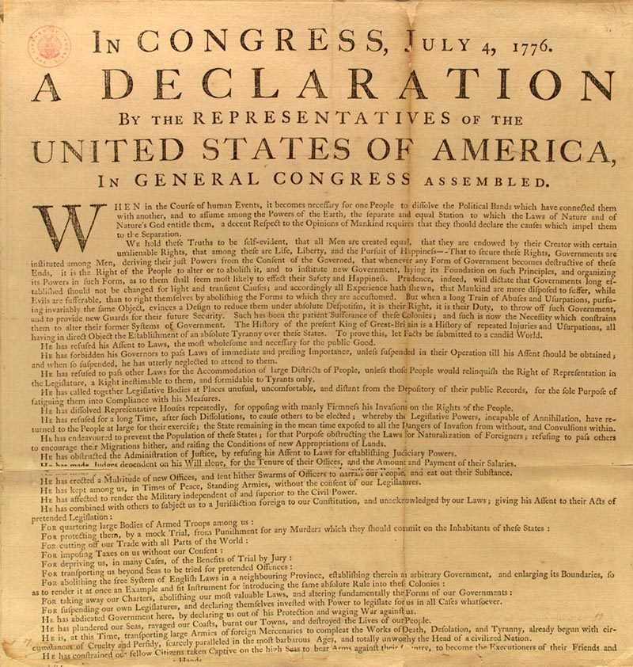
Finally….INDEPENDENCE!!
We’d had enough.
The Declaration of Independence (1776)
Revolutionary War (1775 – 1783)
We win. British lose.

Slide 44
Exit Ticket
Why did many American colonists oppose the British system of mercantilism?
a. It placed quotas on immigration.
b. It discouraged the export of raw materials to England.
c. It placed restrictions on trading and forced the colonies to support Great Britain.
d. It encouraged colonial manufacturing
How did the Stamp Act, the Tea Act, and the Intolerable Acts encourage American colonists to consider revolution against British rule?
a. by ignoring American representatives in Parliament on issues of taxes levied in the American colonies
b. by raising taxes in the American colonies without granting the colonies any representation in Parliament
c. by representing an effort in Britain to end the slave trade in the colonies
d. by revealing the British plan to expand the American colonies farther west on the continent

Slide 45
Reflection
Break Up Letter to the King/Queen
Write a half-page letter to King George (or if you’re a guy and would rather break up with Queen Georgia that’s fine too) explaining why you are dumping him.
Write it like you mean it! You must use at least three specific reasons why the colonists actually “broke up” with England. You can turn them into modern-day situations if you want to. (For instance, “You take all my money and never buy me any presents!”)
Be creative!!!

Slide 46
Unit 1 Quiz
You have 20 minutes to complete this quiz.
You may not:
Use your notes
Talk
Use technology
Keep your eyes on your own paper!
Violators will get a zero!

Slide 47
Articles of Confederation
EQ: What were the strengths and weaknesses of the A of C?

Slide 48
Key Vocab
Confederation – A loose group of states with a weak central government.
Rebellion – Armed resistance against the ruling government.
Central Government – Government for the whole nation.
Federalism – The separation of power between state and federal government.

Slide 49
AoC Timeline
Articles of Confederation - 1777
Sets up a new government. Gives the Continental Congress the authority to manage the War and make deals with other nations.
Intentionally makes the central government weak – result of fear that there could be another king.
Power given to the states!!!!
No Executive Branch(President)
to carry out the laws
No National Court system
to settle disputes between states
Congress did not have the power to tax
No national currency
each state had its own form of money

Slide 50
AoC Timeline Cont.
Land Ordinance Act of 1785 – Set up the requirements for a territory to become a state.
Shays Rebellion
Farmers rise up because they are upset about new taxes.
Defeat the New York State Militia and threaten to overthrow the governor.
George Washington leads the Continental Army and puts down the rebellion.
Shows that the Articles of Confederation are TOO WEAK and must be replaced.

Slide 51
Exit Ticket
Why was government ineffective under the Articles of Confederation?
a. It was too difficult to understand how the government should work
b. Too much power was given to the central government
c. Not enough power was given to the central government
d. It continually favored some states over other states
Under the Articles of Confederation there was no chief executive primarily because of which of the following?
a. the colonists were fearful of a single leader due to their experiences with King George III
b. no one leader won the popular vote
c. the government was bicameral with two executives
d. the colonists wanted each state to have one single leader

Slide 52
Reflection
You may take time to work on your homework packets due tomorrow. You may work together but take this time to ask me questions if need be.

Slide 53
Unit 1 Quiz
You have 20 minutes to complete this quiz.
You may not:
Use your notes
Talk
Use technology
Keep your eyes on your own paper!
Violators will get a zero!

Slide 54
Warm-Up
Imagine the following scenario:
You and your six friends are planning on going to the West Meck basketball game on Friday night. Everyone has to go, or no one can attend. Four of you want to go shoot hoops before the game, but the other three want to get something to eat. There is only one car. The three friends who want to eat say if you don’t do what they want, they aren’t coming. However if you do what they want, the majority loses out on what they want.
How would you resolve this issue?
Is it possible to give the minority what they need at the same time as giving the majority what they want?

Slide 55
The Great Compromise
EQ: How is the Constitution a bundle of compromises? (Great Compromise, 3/5ths Compromise, Electoral College, etc.)

Slide 56
Key Vocab
Minority – The smaller part of a population
Majority – The larger part of a population
Proportional – Equal to each population group
Bi-Cameral – A legislature that is divided into two parts.
Compromise – A mutual agreement between two sides to settle a disagreement.

Slide 57
Background
The founders realized that the Articles of Confederation would not be usable.
They decided that they would need to replace to document.
A Constitutional Convention was called and all 13 original states sent delegates to formulate a new government.
They had to figure out how to create a government that was acceptable to everyone.

Slide 58
New Jersey vs. Virginia Plan
New Jersey
Virginia Plan
Popular with small states
One-House Congress with equal representation
Congress may set taxes and regulate trade
Protected small states with small populations (Minority)
Popular with large states
Similar structure to today’s government. (President, Bi-Cameral legislature, Judiciary)
Representation would be based on population.
Allowed large states with large populations to be dominant. (Majority)

Slide 59
The Great Compromise
The Legislature would have two sides.
The Senate (Equal Representation)
The House of Representatives (Proportional Representation)
This plan would protect the small states, while allowing the large states some level of dominance.
Majority rules, but minority rights are protected.

Slide 60
The Three-Fifths Compromise
Southern states were less populous (fewer people) than Northern states.
They wanted slaves counted as population. This would increase their proportional representation in the House.
Northern State opposed this.
The 3/5’s Compromise settled the dispute by allowing Slaves to be counted as 3/5 of a person.

Slide 61
Exit Ticket
Why was the three-fifths Compromise included in the US Constitution?
a. To make sure that the votes of southern slaves counted less than those of northern whites
b. To allow southern states to include slaves as part of their total population for representation in Congress
c. To make certain that the majority of states accepted the Bill of Rights
d. To increase the overall number of representatives from the northern states
Which issue did the Great Compromise settle so the Constitution could be ratified?
a. The issue of the slave trade
b. The issue of electing the president
c. The issue of slaves counting toward the population
d. The issue of representation in Congress.

Slide 62
Campaign Poster
Create a campaign poster in support of either the NJ or VA plan
Include:
Slogan
Illustration
What the plan includes and your reasoning as to why it is the most fair.

Slide 63
Current Event Discussion
Right to Bear Arms?
Does the shooter have the right to bear arms in this situation? Why or why not?
What would have you do done if you were in the same situation?
Was the shooter in imminent danger?
Moving forward, how do you think this case should be handled?
Do you think he should be tried as an adult?

Slide 64
Warm Up
Who should have more power…the national (federal) government in D.C.? Or individual states? … Explain why.
What do you think is the most important right we have in this country? Why?

Slide 65
Federalists vs. Antifederalists
EQ: How has major arguments for and against ratifying the Constitution (Federalist vs. Antifederalist) shaped American Government?

Slide 66
Key Vocab
Ratify- the final approval for a new constitution or amendment.
Bill of Rights – First ten amendments to the US Constitution.

Slide 67
Federalists & Anti-Federalists
After the Constitution was created, 9 out of the 13 states had to ratify it for it to take effect.
Each state held a special convention (meeting) to debate and vote on ratification.
From these conventions, two groups emerged, Federalists & Anti-Federalists

Slide 68
Federalists
Included Washington, Hamilton, Adams
Favored a STRONG federal govt and WEAK state govts
Supported the Constitution
Didn’t see a need for a Bill of Rights
Wrote the Federalist Papers to support their views

Slide 69
Anti-Federalists
Included Jefferson
Favored a WEAK federal gov’t and STRONG state gov’ts
Feared the Constitution gave too much power to federal gov’t
Required a Bill of Rights
Thought the President would turn into a tyrant like King George

Slide 70
The Agreement
Federalists promised to add a Bill or Rights if the Anti-Federalists agreed to support the Constitution
9th& 10th Amendments addressed the concerns of the Anti-Federalists

Slide 71
Exit Ticket
Which reason best explains why many Anti-Federalists finally agreed to the ratification of the U.S. Constitution?
a. the addition of the Bill of Rights
b. arguments by George Washington
c. a desire to create a better relationship with the Federalists
d. a fear that civil war would break out if the dispute was not settled
Which of the following would most likely be considered an Anti-Federalist argument?
a. The Constitution gives the national government too much power, and it limits both the state’s and individuals’ rights.
b. The creation of an executive leader will lead the country back to a monarchy.
c. A Bill of Rights is not needed because the powers of the national government are already limited through the separation of powers.
d. The Articles of Confederation do not need to be modified, the republic is good the way it is.

Slide 72
Reflection
You may take time to work on your study guides due Friday while we watch America: The Story of Us. You may work together but take this time to ask me questions if need be.

Slide 73
Warm-Up
Good Morning! Around the room you will find exit ticket questions with the correct answers. There are two sets ( one in the front of the room, one over by the green bulletin board).
Grab your exit ticket tracker and change incorrect answers on your trackers.
When you are finished, glue your tracker into your notebook.
After your tracker, glue your unit 1 quiz into your notebook.
You have 15 minutes!

Slide 74
Bill of Rights
EQ: What foundational documents influenced the principles of the Bill of Rights?

Slide 75
Key Vocab
Self-Incrimination – Confessing guilt to a crime.
Indictment - an official written statement charging a person with a crime
Due Process - the official and proper way of doing things in a legal case
Eminent Domain - a right of a government to take private property for public use
Double Jeopardy - causing a person to be put on trial two times for the same crime

Slide 76
The First Amendment
Five Specific Rights
R
A
P
P
S
One – thumb to yourself
“My RAPPS!”

Slide 77
2nd Amendment
…the right of the people to bear arms shall not be infringed.
Two – make a gun

Slide 78
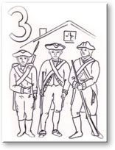
3rd Amendment
No Soldier shall, in time of peace be quartered in any house, without the consent of the Owner, nor in time of war. . . .
Three – middle (3^{rd)} finger
What do you do when soldiers knock on your door?

Slide 79
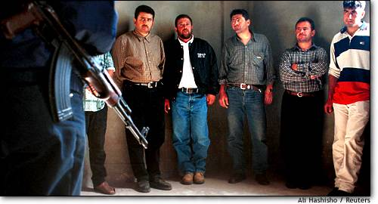
4th Amendment
The right of the people to be secure in their persons, houses, papers, and effects, against unreasonable searches and seizures, shall not be violated, and no Warrants shall issue, but upon probable cause
Four - knock on the door
They need a warrant to come in

Slide 80
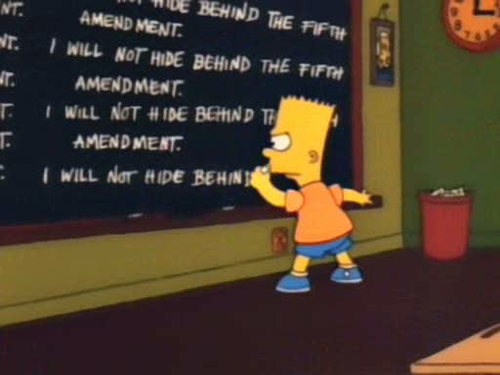
5th Amendment
nor shall any person be subject for the same offence to be twice put in jeopardy of life or limb
[no double jeopardy]
nor shall be compelled in any criminal case to be a witness against himself [no self-incrimination]
Due process of law
Emininent Domain
Five – hand over mouth
Right to remain silent!

Slide 81
6th Amendment
In all criminal prosecutions, the accused shall enjoy …
the right to a speedy and public trial by an impartial jury
to be informed of the nature and cause of the accusation
to have the Assistance of Counsel for his defense [an attorney]
Six – hand and a thumb (fingerprint)
Criminal rights

Slide 82
7th Amendment
In Suits at common law, where the value in controversy shall exceed twenty dollars, the right of trial by jury shall be preserved….
[jury trial in civil cases]
Seven – five plus two in a “v”
V in “civil”

Slide 83
Eighth Amendment
No excessive bail
No cruel and unusual punishment
Eights – crazy 8s!!
No crazy punishments!

Slide 84
9th Amendment
Nine – mine!!
Other rights, like privacy
The enumeration in the Constitution, of certain rights, shall not be construed to deny or disparage others retained by the people
People have rights beyond what is written in the constitution
[other rights may be protected even if they’re not in the Bill of Rights… ex: right to privacy]

Slide 85
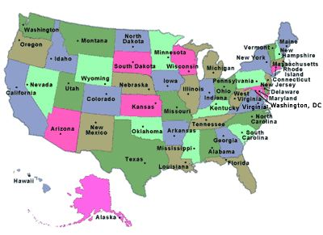
10th Amendment
Ten – them
States’ rights
The powers not delegated to the United States by the Constitution, nor prohibited by it to the States, are reserved to the States respectively, or to the people.
[states' rights]

Slide 86
Exit Ticket (Turn it in when you’re finished)
An individual has been accused of taking the property of another person. Why would a judge require substantial evidence before issuing a search warrant?
a. to prevent law enforcement officials from having to testify in court
b. to guarantee an arrest by law enforcement officials
c. to avoid self-incrimination by the suspect who took the property
d. to ensure there was probable cause for conducting the investigation

Slide 87
Act them out!
Work in groups of three.
I will assign you an amendment.
With your group, you have 15minutes to come up with a SHORT (less than 60 seconds) skit that somehow illustrates the amendment.
Be creative. Use props. Use the furniture.
As you are watching the skit, write down the group number, and then guess what amendment it is.

Slide 88
Reflection
What would society be like if we didn't have the Bill of Rights
Explain what life would be like if we lacked a Bill of Rights. What would be different?
Answer in a paragraph or two.

